Slide 1
What marine environment attributes are most important to coastal residents and how do these influence attitudes toward wave and tidal energy? A photo-elicitation study on the Bristol Channel, UK.
Andrew Edwards-Jones, Caroline Hattam, Tara Hooper
& Nicola Beaumont, Plymouth Marine Laboratory
aej@pml.ac.uk
@AndyEJ5

Slide 2
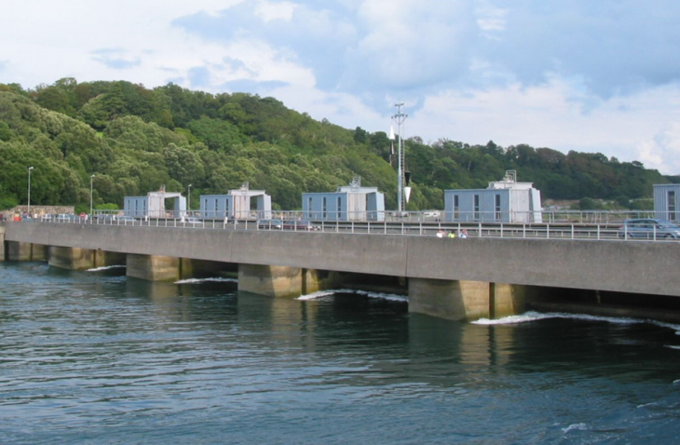
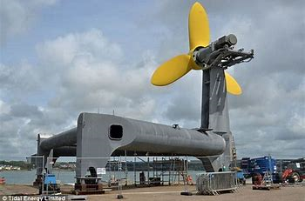
Context
Bristol Channel as a source of untapped clean, renewable tidal energy
Public perceptions of marine energy technologies and their impacts
Complimentary public survey (N=960)
Aim of project: Target recreational users and local residents to explore the different cultural benefits they perceive from engaging with their local coastal/marine environment
Notes:
Part of a wider project called ADVENT (Addressing the Valuation of Energy & Nature Together) – a 5yr programme to examine how energy developments interact with the ecosystem services and natural capital provided by terrestrial and marine environments?
With a tidal range of up to 14 m, one of the largest in the world, and tidal speeds around 8 knots, the Bristol Channel offers a massive resource potential to provide the UK with clean, low carbon energy

Slide 3
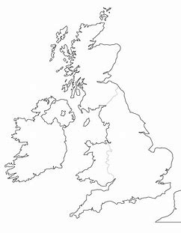
Case Study Sites
Weston-super-Mare
Minehead Watchet
Taw Torridge
Notes:
Potential development sites have been identified over the years, hence case study locations correspond to these and represent urban/semi urban areas.

Slide 4
Methods
Photo Elicitation study
Mini-literature review key take-outs
Draws on concepts of empowerment, participatory action research, and place attachment.
Similar approaches labelled as reflexive photography; autodriving; photo voice
Photo-elicitation refers to the combined activities/process of taking photographs and discussing/analysing these during a follow-up interview
Raft of benefits over conventional interviews
Methods recorded tend to be quite formulaic, with some variations
Data analysis methods: Process and/or content, text and visual analysis
Notes:
Benefits of PE: Collaborative between interviewer and interviewee, builds rapport and trust, non-directivity, higher level of engagement by interviewee with subjects and themes, combines visual and verbal language, provides a component of multi-methods triangulation to improve rigour.
Variations: collective briefings and training, site tours with photographer, photographs as data or prompts

Slide 5
Methods (cont)
Sample
Following unsuccessful attempts to solicit interest through targeted methods, participants recruited immediately after completing marine energy survey
Self-selected (N=80)
Final sample = 15 residents + 4 local marine environment users (sea anglers/boat skippers)
Process
Briefed by researcher
Sent broad guidance, background info and consent forms
Photos taken by participants using own equipment of choice, or chose from existing photos
Photo elicitation interview held locally
Notes:
Interview transcripts, participant photographs, and selected attributes from survey data were all imported into Nvivo 12.

Slide 6
Key Findings
Demographics
Notes:
Explain MMO’s coastal typology: Published in 2011, the approach intended to provide an overview of the types of coastal communities and their characteristics, for use by planners to identify how the impacts from marine activities might affect those communities. A1 Coastal retreats: Silver seaside; B1 Coastal challenges: Structural shifters; C1 Cosmopolitan coast: Reinventing resorts; D2 Coastal fringe: Working hard
Also note that length of residence worth noting: 10 yrs and less = 5, over 10 years = 10.

Slide 7
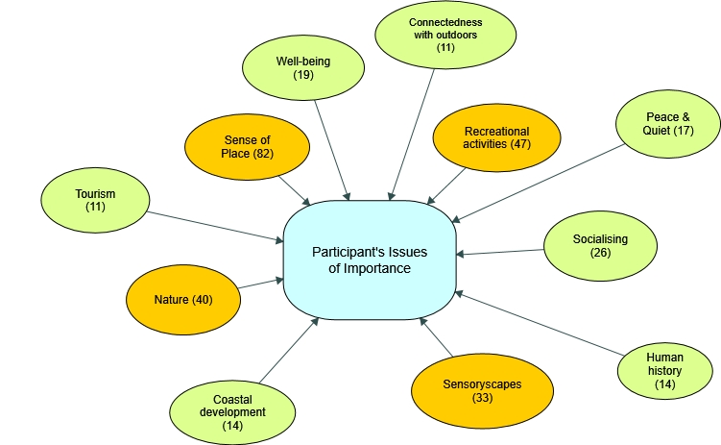
What marine environment attributes were most important to the participants?
Notes:
Following thematic analysis completed over 3 iterations, the following Concept Map shows the attributes participants identified as being the most important to them.
The 4 themes shown in orange were the strongest themes, by no. of references in the elicitation interviews.

Slide 8
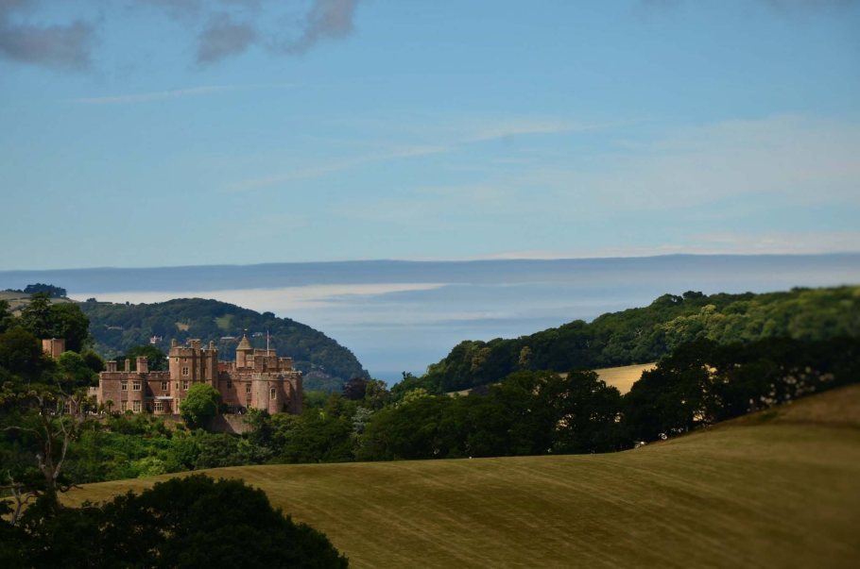
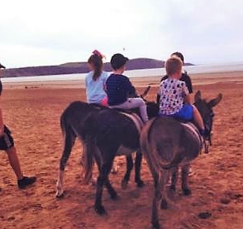
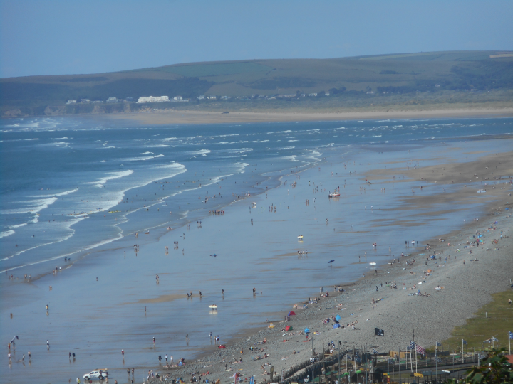
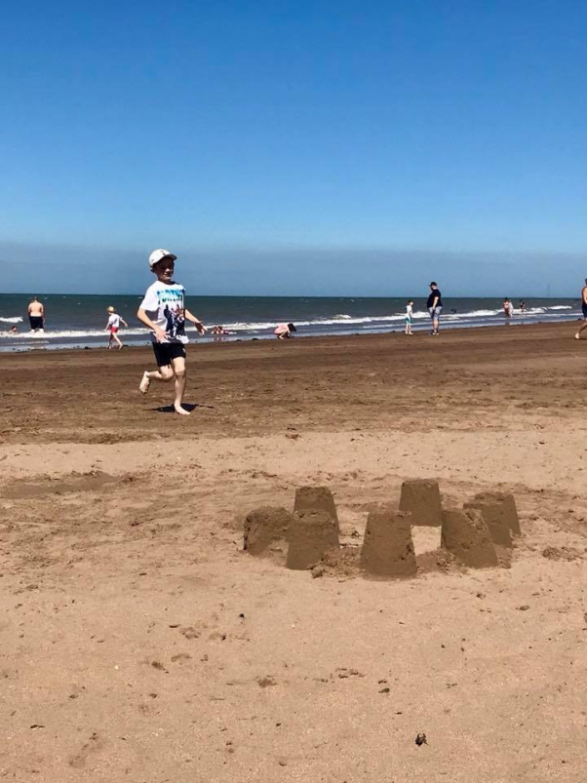
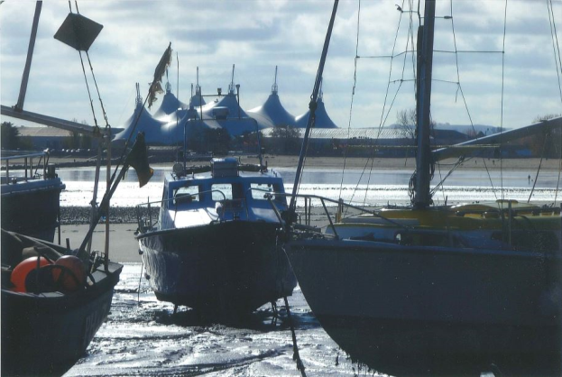
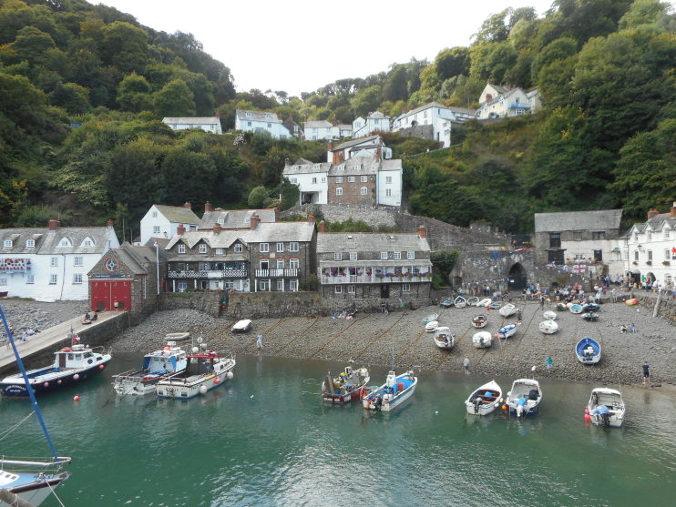
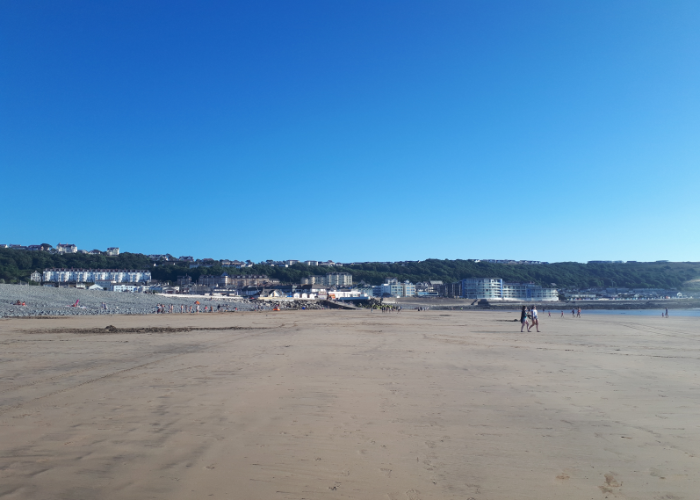
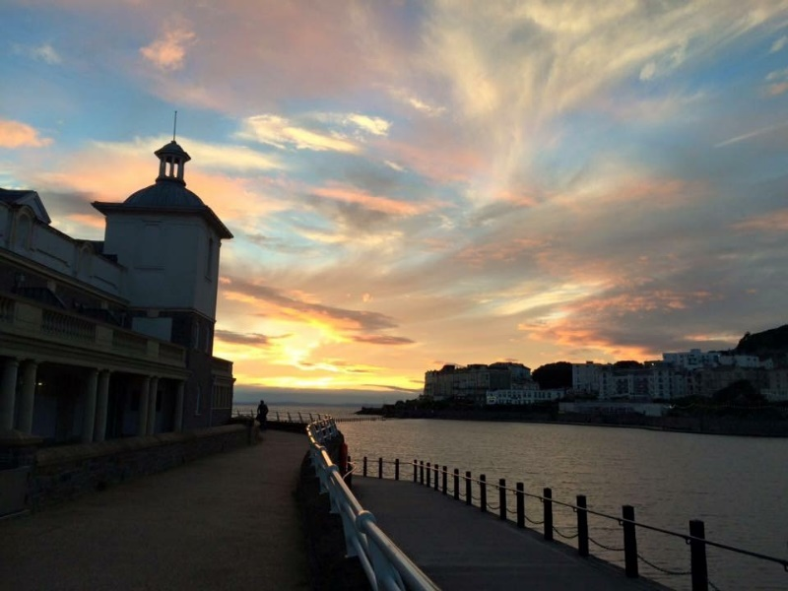
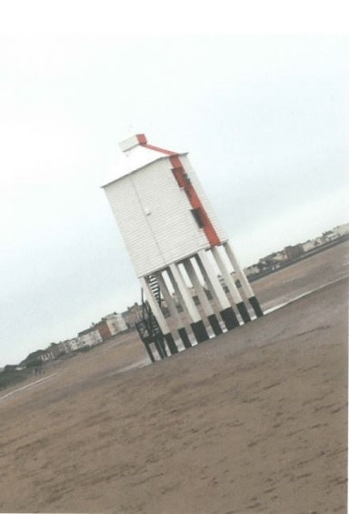
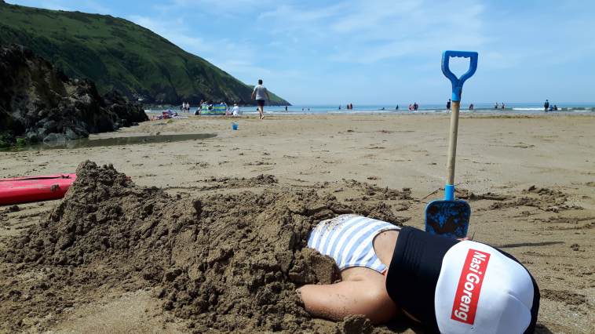
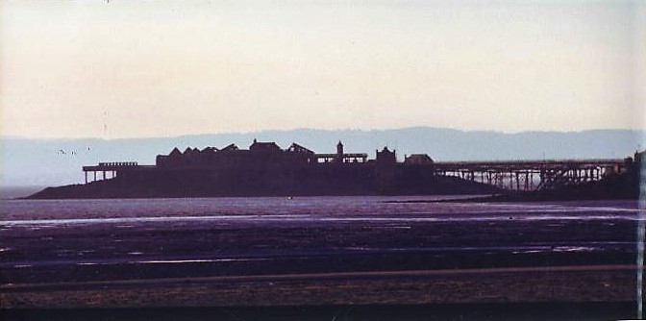
Sense of Place
Well I was born here, so I have lived here for my whole forty four years. Well you know, who is going to leave a place like this, you’ve got everything here haven’t you? You’ve got friendly people, you’ve got lovely beaches, you have got beautiful coastline obviously, as you well know and yeah, it is just a lovely, lovely place to live
It still comes out as number one on TripAdvisor as best beach in the UK…and it is at the heart of why we moved to North Devon in the first place. We used to come on holiday here every year with the purpose of spending our time on this particular beach...
Notes:
Comprises the sub-themes:
Attachment to Place (56)
Memory-making (15)
Nostalgia (11)

Slide 9
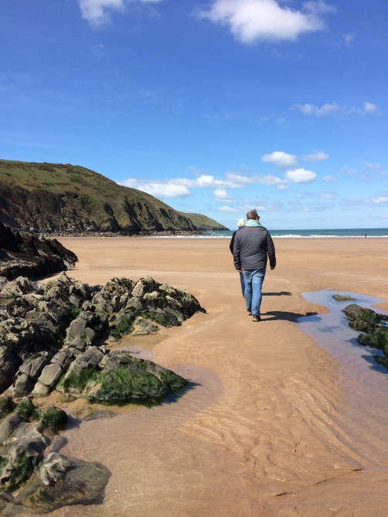
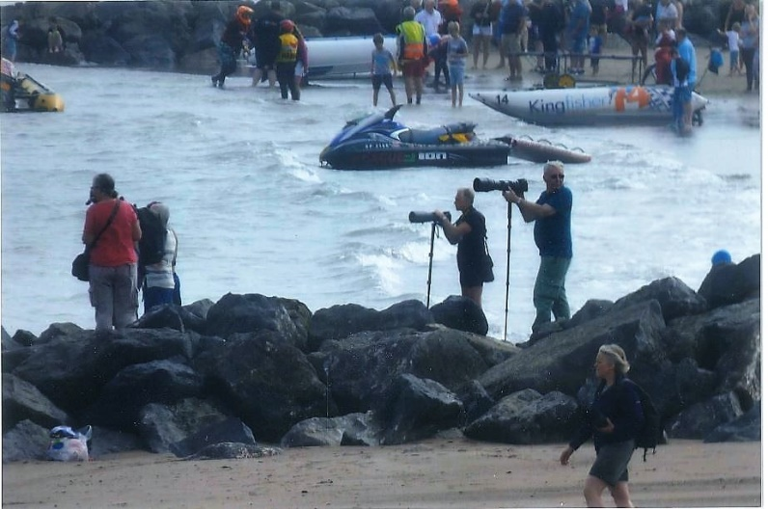
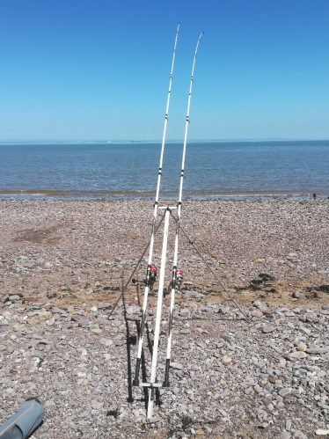
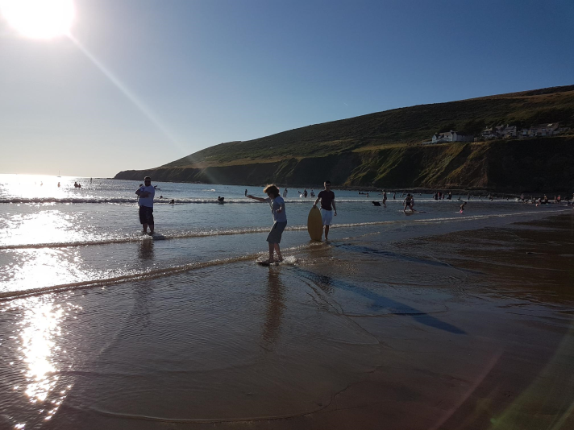
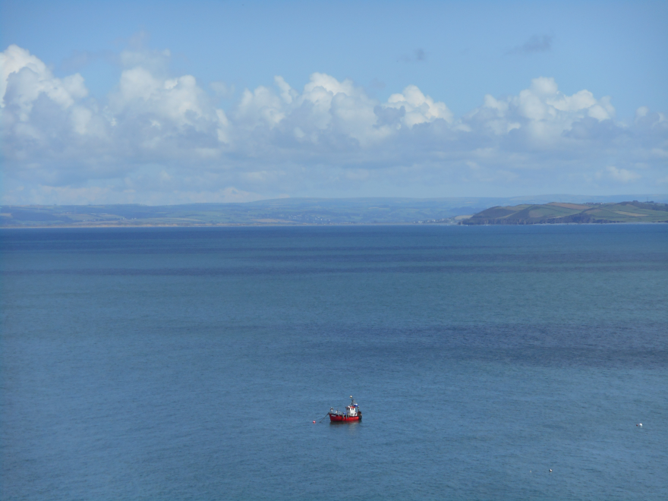
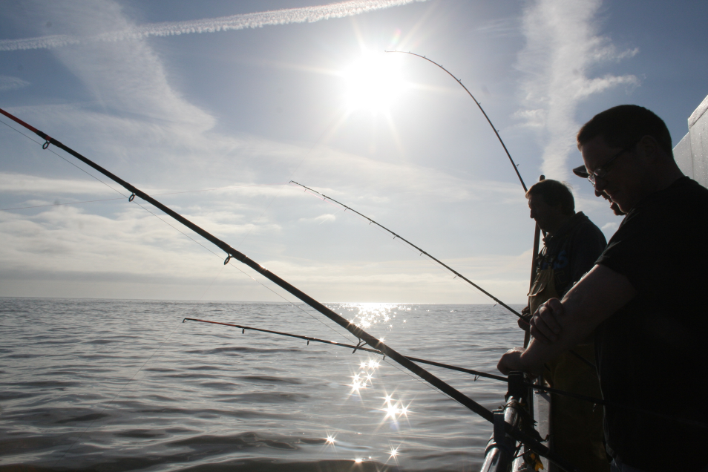
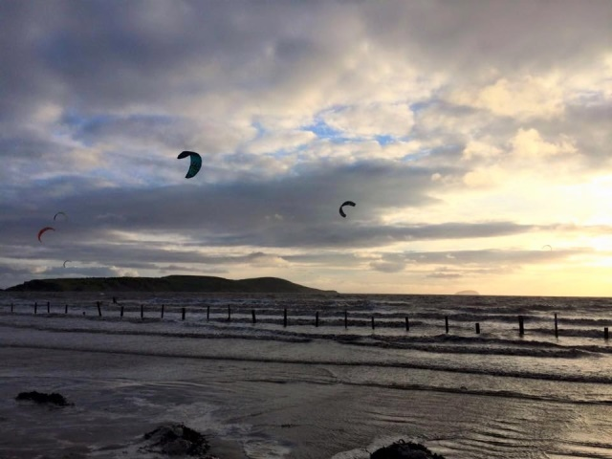
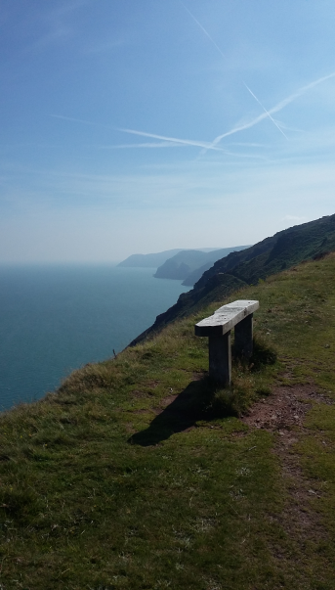
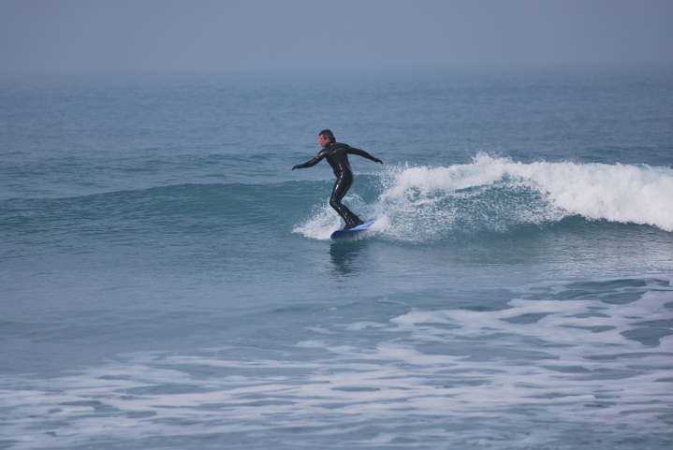
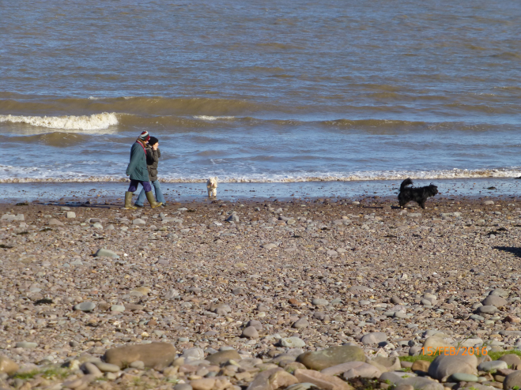
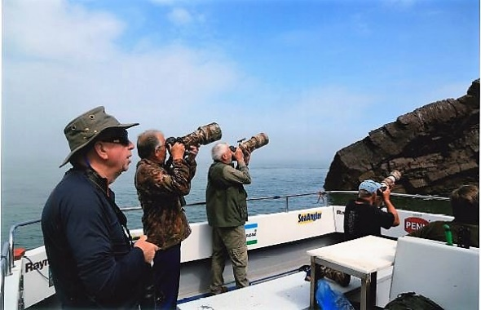
Recreational Activities
Notes:
Sub-themes can most simply be considered as:
Land-based activities (23)
Sea Angling (13)
Water-based activities (11)

Slide 10
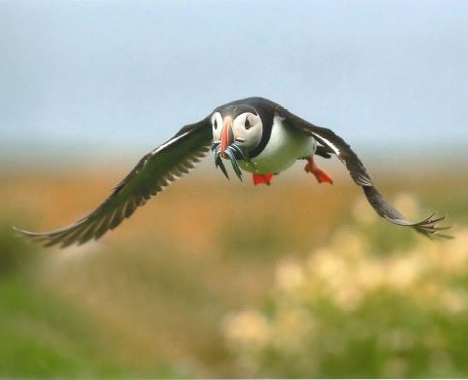
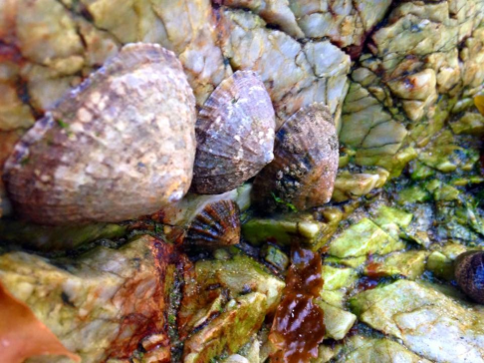
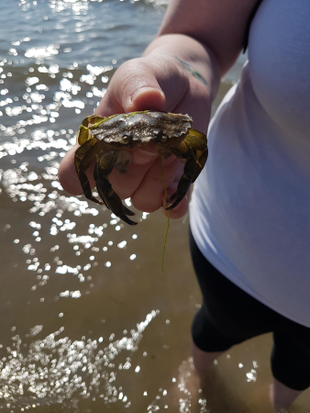
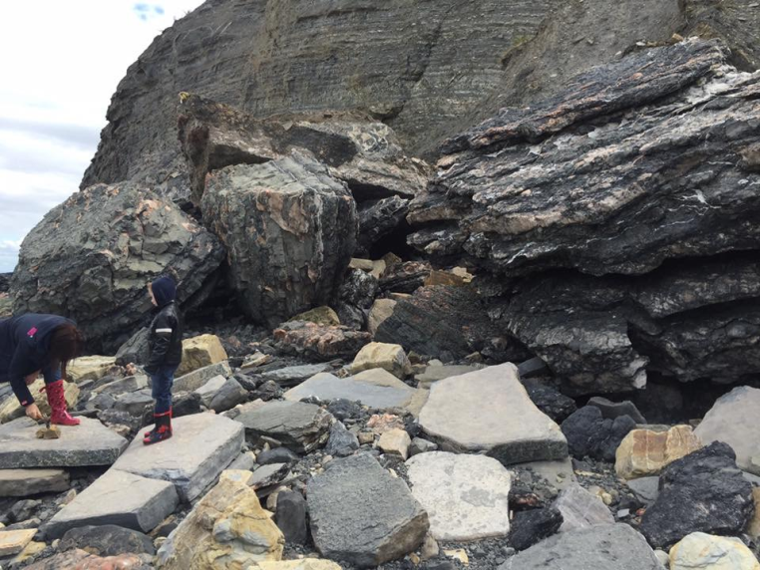
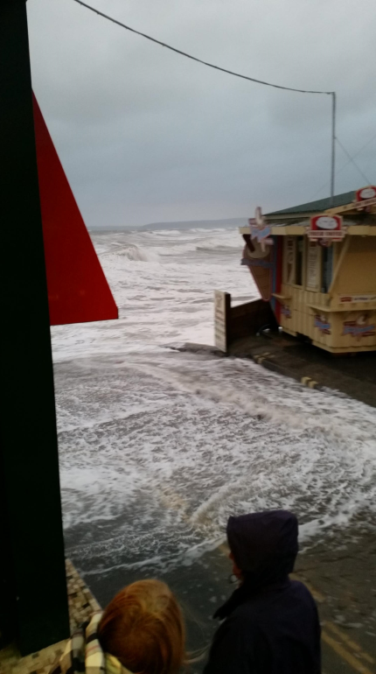
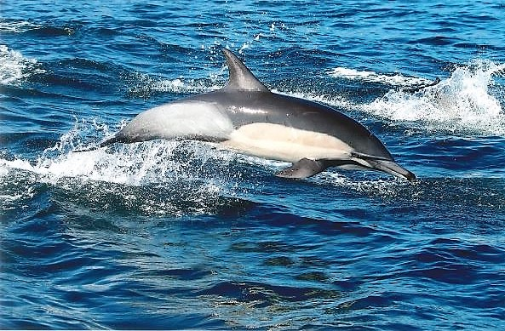
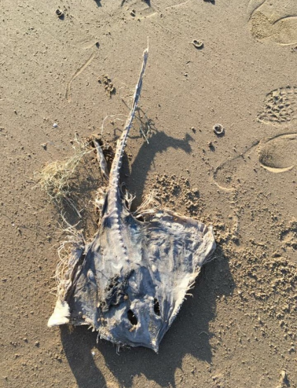
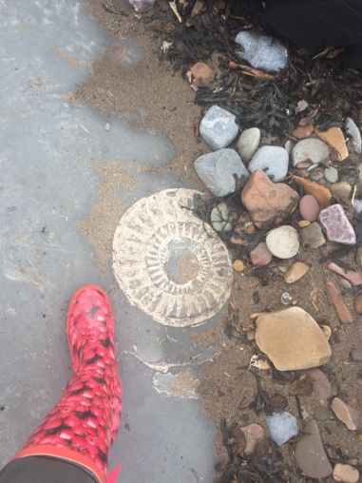
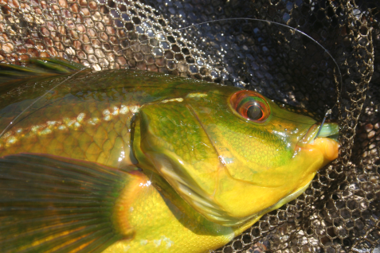
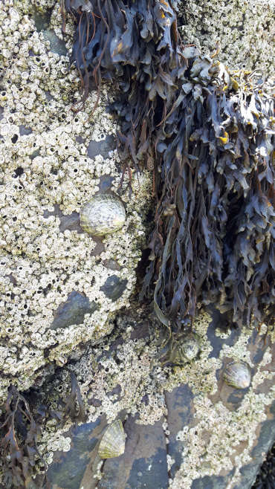
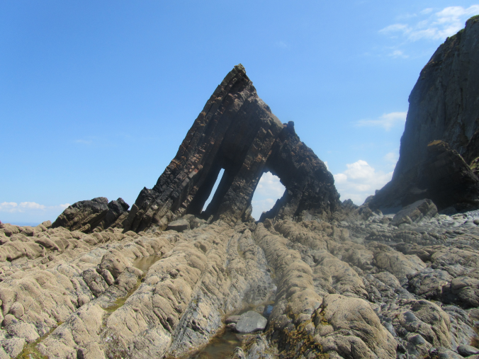
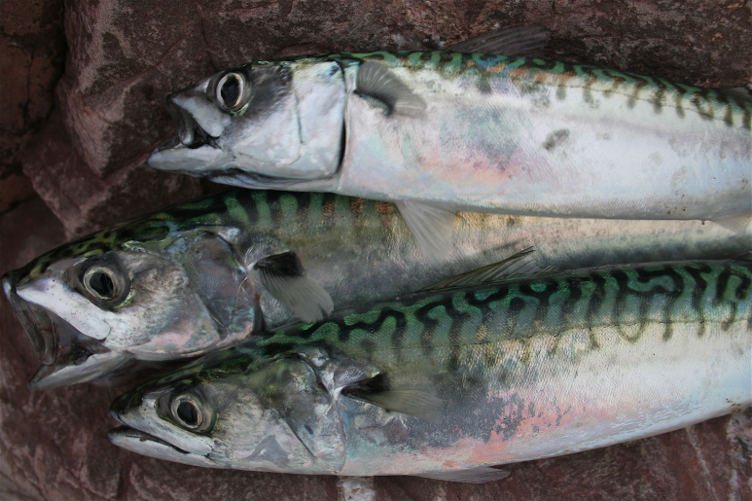
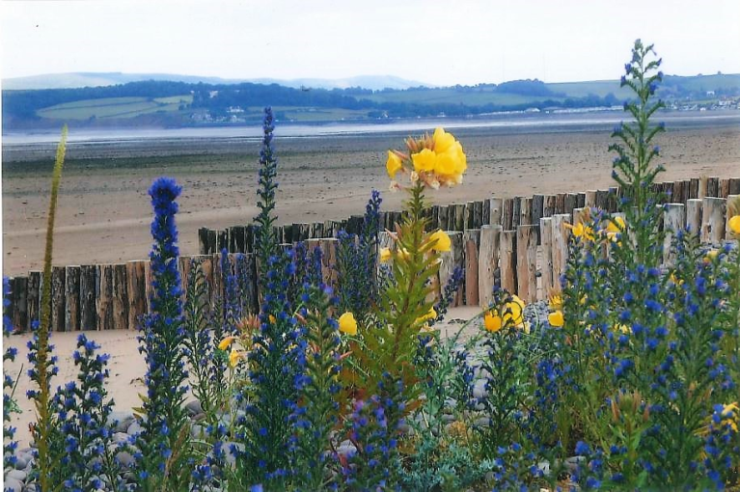
Nature
Yes, I just enjoy being out there, I mean, what was it? Coming back earlier in the year things were very quiet, I wasn’t catching anything but we had absolutely hundreds of jelly fish going by, so things like that interest me.
www.alykatimages
Notes:
Sub-themes:
Wildlife (26)
Geology (7)
Weather (2)
Fish stock (5)

Slide 11
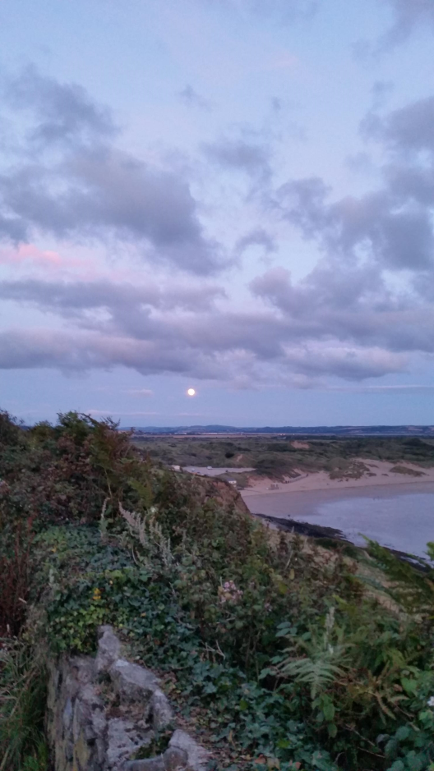
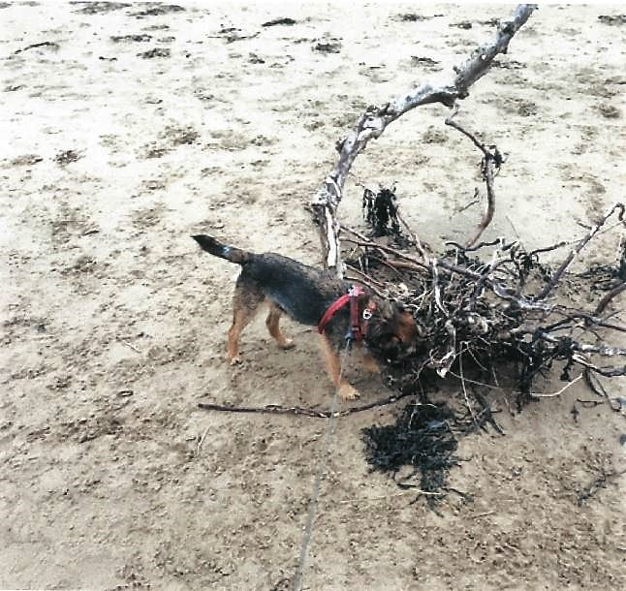
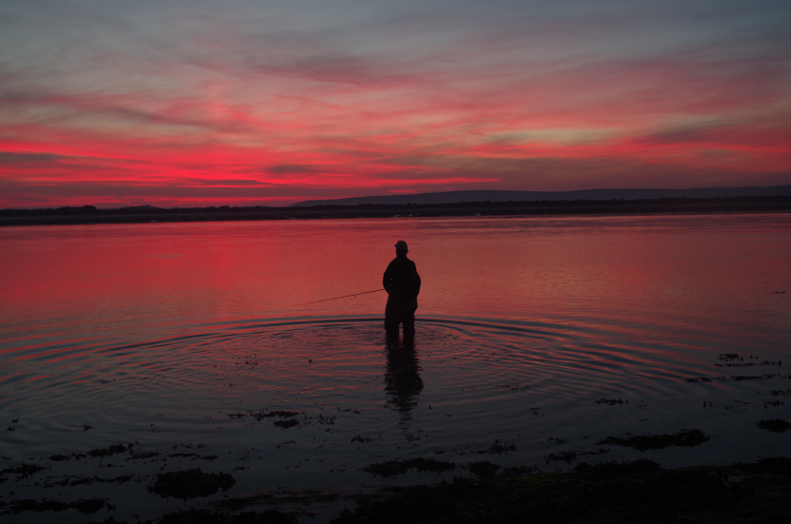
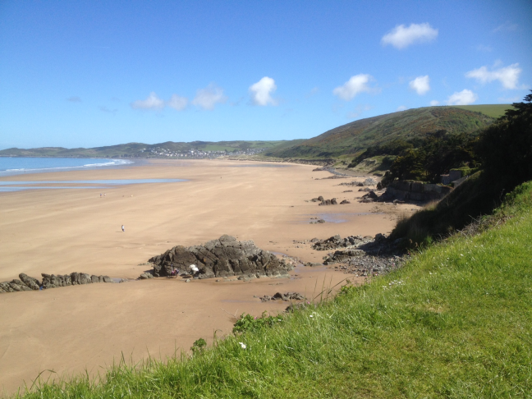
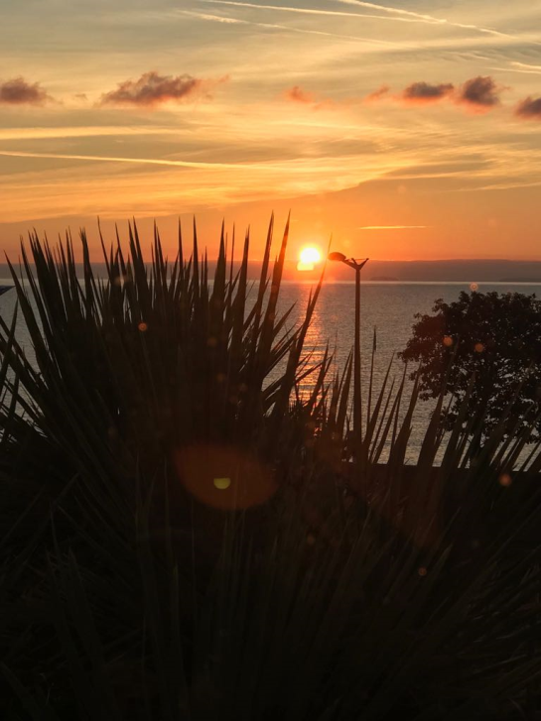
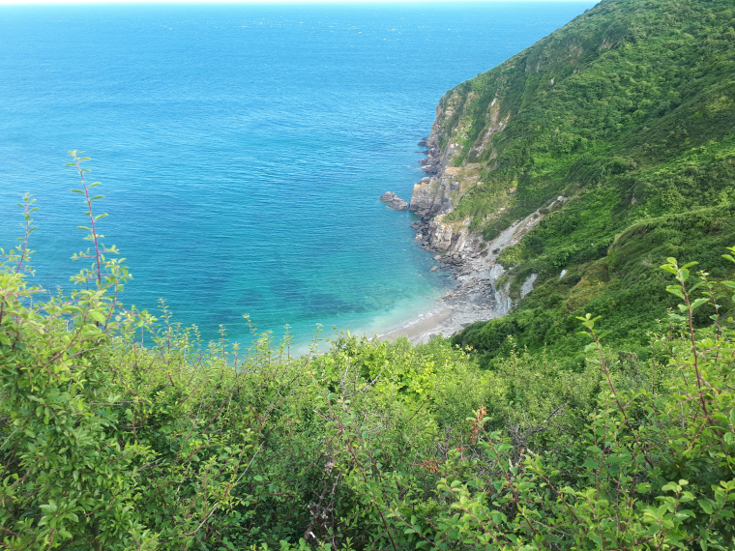
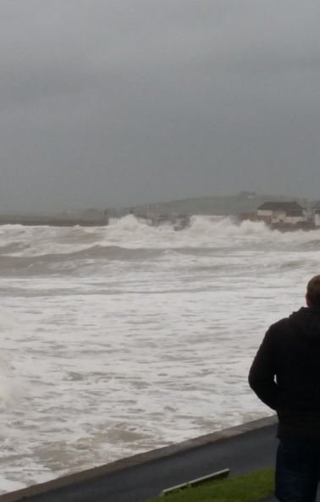
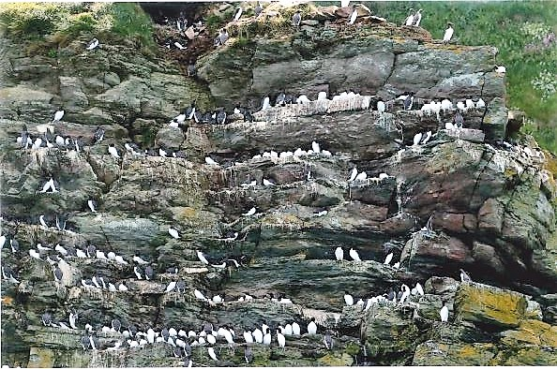
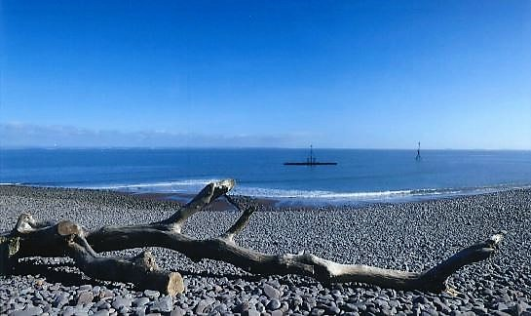
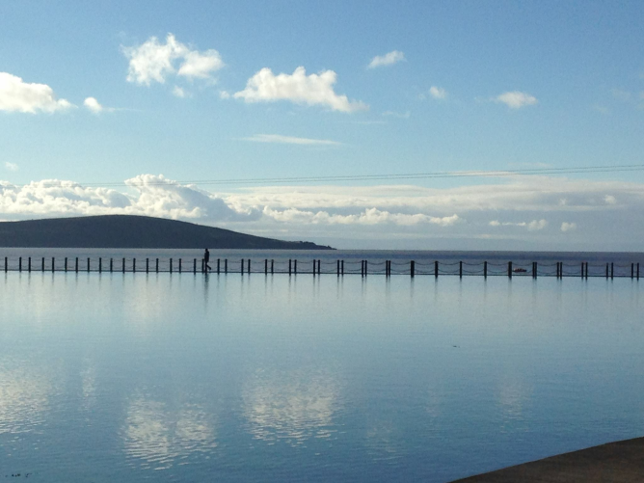
Sensoryscapes
It is like the largest bowl of cocoa pops in the world and it is… just beautiful the sound, just the constant gentle rumbling and yet the sound of the birds seems to penetrate that still.
The fact that it is so unspoiled I think, there is, it is not towny…we have just come back from a weekend in South Devon…nice places but they are not here, you know ,it is so not like this, um I think it is keeping the development in check, so you don’t kill the goose that laid the golden egg, because if you take away those views, people won’t come anymore.
Notes:
Sub-themes:
Visualscapes (24)
Soundscapes (6)
Olfactoryscapes (3)

Slide 12
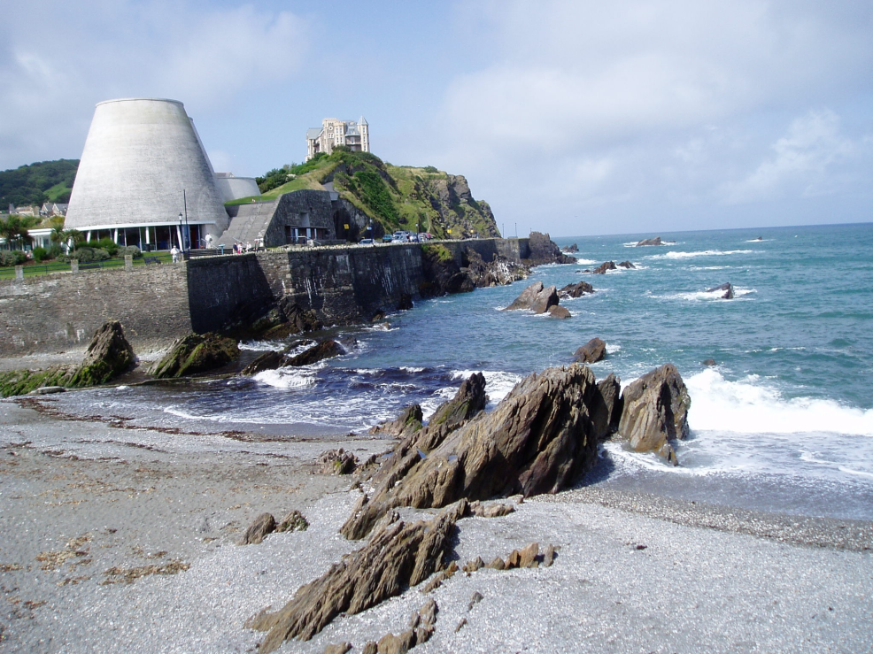
Other themes
This is ‘therapy’, so this is my grandad, he is lucky enough to have a sea view from his bungalow, he is 91 and he just broke his hip, and he was desperate to come out [of hospital] and… I just thought it must make such a difference to live in that bungalow and be able to look out at the sea
Notes:
Medley of photos representing the remaining themes:
Social factors (family & friends, interactions)
Health and wellbeing (mental, physical)
Peace and quiet (solitude, freedom, openness)
Human history (heritage)

Slide 13
Perceptions of Tidal Energy
Notes:
Concept map showing the key perceptions of tidal energy based on a direct question in the elicitation interviews.
Again, the themes highlighted in orange reflect the higher frequencies of relevant references made by the participants.
Need more info – 6 people gave 8 references

Slide 14
Trade-offs
Wide range of deliberations in respect of supporting tidal energy developments i.e.:
Efficiency/development cost/visual impact/economic gains/environmental impact/sustainable energy/nuclear station/wildlife/tourism/jobs
“I am very keen on having energy derived from water, um so I wouldn’t be… as long as any schemes didn’t actually ruin the coast, I would be all for them, because I think we have to have a bit of give and take on things like this. It is all very well and good to say we don’t want anything, but sooner or later we have got to sort the energy problem out” (PML 017)
Notes:
Many participants articulated a wide range of deliberations in respect of supporting tidal energy developments.
Examples of trade-offs
Competing interests over efficiency
Cost savings over visual impact
Economic gains over env impact
Government financing over local burden
Personal gains over negative impacts
Some visual impact over continuing unsustainibility
Subtle construction over cost of development and visual impact
TED over nucleur power station
Tidal energy over enjoyment of coast
Tidal energy over wildlife
Tourism over tidal energy
Visual impact over developer incentives
Wider benefits over family losses
Wildlife over jobs
Wildlife over Tidal energy
Quote is a typical example. Generally positive, but flip it around and could be read as ‘any development that might be perceived as potentially ruining the coast would be opposed’

Slide 15
Support for tidal energy
From survey, 14 of 15 participants indicated they would support or strongly support tidal energy development in local area
From PE study, 12 of 19 explicitly positive about tidal energy (2 not surveyed)

Slide 16
Sustainability of tidal energy
Notes:
Main reason for using a word cloud here is to show the use of other, probably more familiar types of energy production, as a way of comparing tidal energy

Slide 17
Perceived impacts of tidal energy developments on issues of importance
Notes:
We did ask an explicit question around impacts of tidal energy developments on the issues of importance participants had raised during their interviews and with photos, but this figure probably doesn’t tell the whole story because it closely overlapped with the more general question asked about perceptions of TE.
These perceptions can probably be thought of in a reciprocal way – e.g. wildlife is an important issue therefore any impact of TED on wildlife will be of concern, and any perception of TE will be influenced by perceived impact on wildlife.

Slide 18
Environmental Impact
Validation of findings against wider survey results
 | Positive impact | Negative impact | Total
No. of participants | 4 | 5 | 9
No. of references | 4 | 6 | 10
Total | 8 | 11 | 19
Perceptions of Env. Impact from tidal energy developments
Analytic Hierarchy Process (AHP) weights from SW Energy Survey
Notes:
The responses on env. Impact from the previous slide does not tell the whole story. When we break down the responses by content we actually find a split between perceived positive and negative impacts of TED on the env.
With the survey, an Analytic Hierarchy Process was used to compare the importance of environmental impact, job creation, reliability and cost based on pairwise choices with each characteristic pitched against the other.
The weighted AHP scores are plotted here for the whole survey sample (blue diamonds) and the extracted scores for our study participants (red squares).
Very little difference between them for local job creation, cost and reliability; but significant difference for local environmental impact. Our sample’s concern about LEI was considerably elevated above that of the wider population. Just about supported by the figures in the table but shows the benefit of qualitative method here because the survey guidance note for the AHP question clarified LEI in negative terms. The interview responses revealed some perceived +ve impacts on the envrt of the construction of tidal energy devlpts.

Slide 19
Factor analysis of survey responses:
Sense of place = 2 factors loaded – ‘Family and friends’ and ‘other wider characteristics’
Coastal Activities = 3 factors loaded - ‘Active participation’, ‘beach activities’ and ‘wildlife watching’.
Supported by photo elicitation study adding further validation of findings?
Notes:
Other wider characteristics include landscapes, wildlife and recreation
Active participation = water sports
Beach activities – relaxing, swimming for leisure, playing with children
The measure for the activity ‘enjoying scenery from the car’ was actually quite low whereas the PE study clearly shows that scenery is important but is an immersive experience – they live and pursue interests ‘in’ the scenery rather than just looking at it.

Slide 20
Summary
Key points | Message for developers/planners
Strong attachment to place | Understand what this looks like
Passionate about local wildlife | Give facts
Views are sacrosanct | Don’t mess with the views
Range of recreational activities | Avoid restricting activities
People are willing to trade-off between clean, renewable energy source and other coastal benefits… | …but need to be addressed
Settled communities more receptive to MRE development… | …if above points are understood
Notes:
Original question was: What marine environment attributes are most important to coastal residents and how do these influence attitudes toward wave and tidal energy?
Project sample more environmentally conscious than wider community, hence their perceptions are arguably doubly relevant.

Slide 21
And next?
Further mixed method analysis to provide more depth to survey results > possible case studies
Place participant responses into an ecosystem service context/test ES frameworks
Integrate findings with other ADVENT projects for policy/practice briefs
Notes:
Ultimately, ADVENT seeks to provide both public and private sector decision makers with tools that allow them to take a whole-systems perspective on energy futures in a way that integrates energy and environmental considerations.

Slide 22
Thank you!
aej@pml.ac.uk
@AndyEJ5

